Slide 1
Review Chapter 5:
Computing Components

Slide 2
Key points
Read and ad for a computer and understand the jardon
List the components and their function in a von Neumann machine
CPU, CPU registers, CPU cache, Memory and RAM, Input and Keyboard, Output and Screen, Bus, Hard Disk and Secondary Storage，BIOS and ROM
Describe the fetch-decode –execute cycle of the von Neumann machine
Describe how computer memory is organized and accessed
Name and describe the various auxiliary storage devices

Slide 3
Von Neumann architecture
Program
Input & Output
Arithmetic Logic Unit
Memory
Input Data
Output Data
Control Unit
Computer

Slide 4
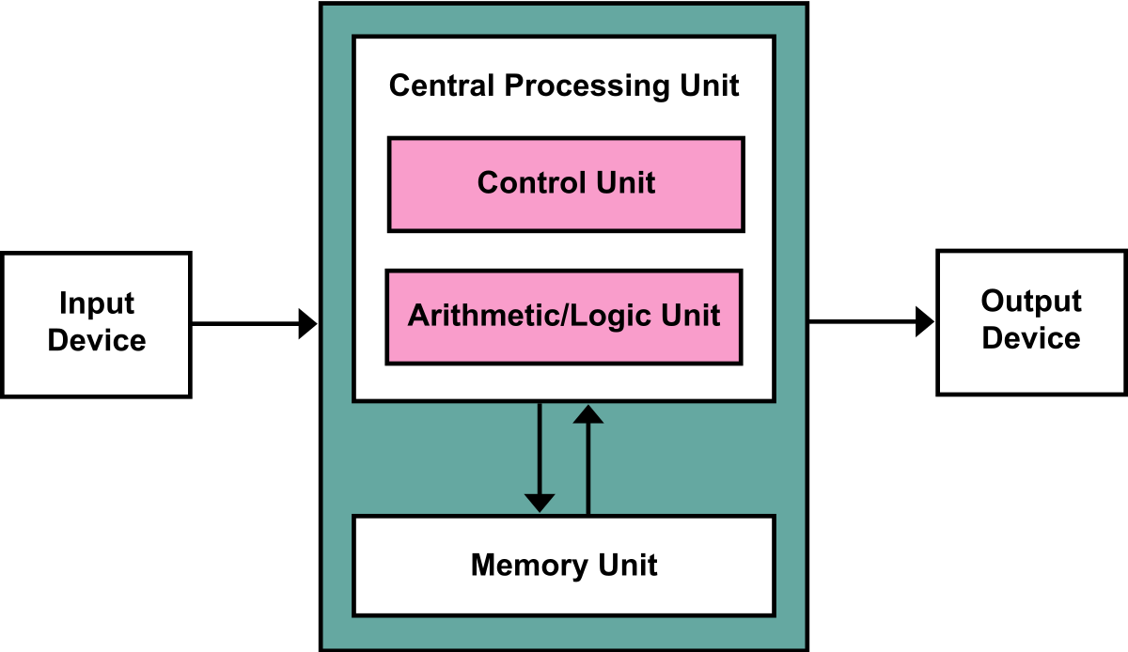
Von Neumann architecture

Slide 5
Central Processing Unit (CPU)
Three parts
Arithmetic Logic Unit (ALU)
Performs arithmetic and logical operations
Registers
Data registers
Instruction registers
Program counter (also a register)
Control Unit

Slide 6
Memory types
Two types: RAM and ROM
Random Access Memory (RAM)
Can be read and write (many times) by users
Volatile, data erased if the system is powered down.
Two categories:
Static RAM: using flip-flop gates; refresh no needed
Dynamic RAM: using capacitors; refresh needed;
Notes:
SRAM :根据电子器件的双稳态原理来存储信息。在不断电的情况下，信息不会丢失，不需要刷新。功耗大、集成度低，运行速度比DRAM快，一般用作Cache。
DRAM：使用电容充电原理来存储信息。由于电容会漏电，所以必须对立面信息定期更新才不会丢失信息。功耗小，集成度高，用作主存。

Slide 7
Input and Output
Enable computer to
communicate with outside world
store programs and data even when the power is off
Two categories
Non-storage: keyboard, monitor, printer … …
storage devices
Magnetic storage devices, optical storage devices

Slide 8
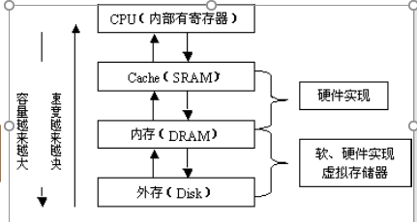
Memory hierarchy
Factors: speed, size and cost!
Features
Speed：main memory < cache < registers
Size: main memory > cache > registers
Cost: main memory < cache < registers
Registers
(Fastest, small size)
Cache Memory
(Faster, larger size)
Main Memory
(Fast, more-larger size)

Slide 9
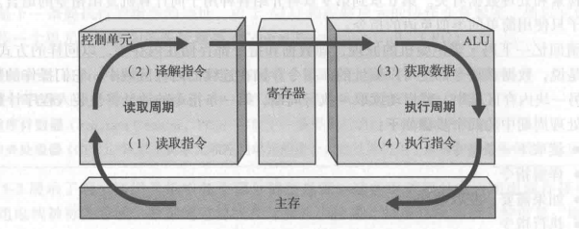
The Fetch-Execute Cycle
The processing cycle includes four steps:
Fetch the next instruction
Decode the instruction
Get data if needed
Execute the instruction

Slide 10
Key Terms
Motherboard
个人计算机的主电路板
Program Counter(PC)
存放下一条要执行的指令的地址的寄存器
Transfer Rate
数据从磁盘传输到内存的速度
Instruction register(IR)
存放当前正在执行的指令的寄存器
Input/Output Unit
接收要存储在内存中的数据的设备
一种设备，由于把存储在内存中的数据打印或者显示出来，或者把存储在内存或其他设备中的信息制成一个永久的副本
Cylinder/Sector/Track
所有磁盘表面的同心磁道的集合
磁道的一个区
磁道表面的同心圆
Access time开始读取一个数据块之前花费的时间
Addressability
内存中每个可编制位置存储的位数
CPU计算机的大脑，中央处理器，由算术逻辑单元和控制单元组成
Arithmetic/logic unit(ALU)
执行算术运算和逻辑运算的计算机部件
Bus width
可以在总线上并行传输的位数
Cache memory
一种用于存储常用数据的小型高速寄存器
Control unit
控制其他部件的动作，从而执行指令序列的计算机部件

